Slide 1
Reading at Home
Tuesday 14th November 2023
Mrs Beale and Mrs Harris

Slide 2
What we will cover
What is reading and why it is important
How is ‘reading for pleasure’ different?
How to support your child learn to read
How to make reading fun
How to read with your child at home and develop a love of reading
Questions

Slide 3
What is reading?
Reading is the process of looking at written symbols and letters and understanding the meaning of them.
It is one of the four main language skills alongside listening, speaking and writing.

Slide 4
What is reading for pleasure?
Reading for pleasure is the act of reading out of choice, recognising the enjoyment that is gained from it.
Research shows that reading for pleasure:
Can enhance empathy
Can raise levels of confidence
Can provide children with an opportunity for escapism
Can fuel a curiosity in the real world

Slide 5
Different types of books
School decodable books
Fiction books
Non Fiction books
Poetry books
Comics, magazines and newspapers
Audiobooks

Slide 6
Why is Reading so vital?
Reading is a skill needed every day, it is all around us.
Reading allows you to learn
It develops language, imagination, Role play, creativity, empathy, help deal with emotions
Reading helps builds bonds between a child and their care giver
Choosing
It is never to early to start to read to your child

Slide 7
Reading every day
We read all day, every day
Road signs, our phones, whilst watching the TV, bus time tables, car parking machines, restaurants, price lists, contracts, instructions, cooking, at the drs.
https://www.youtube.com/watch?v=LrEk-e6cYkQ
https://youtu.be/iNumRNcAF1Y

Slide 8
Where and when?
Shared reading can be any time.
You can help by:
Finding a quiet time to share a book
Finding a place that is comfortable, where you are both relaxed
Giving your child a choice in what they would like to read with you
Showing an interest in what your child is reading – you might need to ask a few question to get them talking about what they are reading
Making it a fun activity – the more fun they get out of it, the more they will want to read

Slide 9
How to choose books
Children may be drawn to books that are based on their favourite things eg, football, fairies, Paw Patrol
Look at the front cover and blurbs of books with your child, flick through the pages. Build their excitement and curiosity
Ensure the book is age appropriate not necessarily ability appropriate
Seek out recommendations from friends, the school, family, local libraries, online
Be involved

Slide 10
https://www.youtube.com/watch?v=iHMl70ZmxIQ

Slide 11
Why is bedtime a great time to read a story
Sets a routine, cues sleep time
Helps bond you and your child
Contributes towards your child’s brain development
Helps lower stress levels
Enhances their communication, language and listening skills
Enhances their logic skills (build favourite stories and then retain parts of the book)
Encourages love of reading

Slide 12
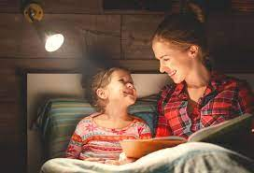
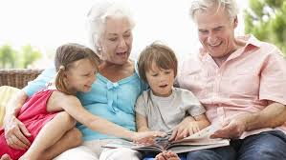
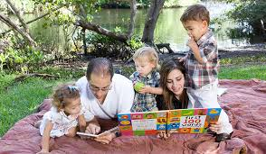

Slide 13
Questions/discussions
Please feel free to browse books we have out, ask any questions or discuss reading in your home

